Slide 1

Classification, Reserve & RQO determination of water resources in the Mvoti to Umzimkulu Water Management Area
SCENARIO COMPARISON
(MULTI CRITERIA ANALYSIS)
Pieter van Rooyen
WRP
16 September 2015
PRESENTATION TITLE
Presented by:
Name Surname
Directorate
Date

Slide 2
Layout of Presentation
Estuary Scenarios:
  Multi Criteria Analysis and scenario evaluation (recap)
  Integrated assessment and overall ranking of scenarios.
  Observations.
  Covering the three estuary IUAs:
    Northern Cluster (iLlembe DM)
    Central Cluster (eThekwini MM)
    Southern Cluster (Ugu DM)
uMngeni and Lovu Scenarios

Slide 3
Why Multi-Criteria Analysis?
Method to compare alternatives where the outcomes (consequences) are in different numerical terms.
Ecological consequences is a relative rating while economy is in monetary terms and employment in numbers.
Multi-Criteria Analysis is appropriate in these circumstances.

Slide 4
Application of MCA model results
The numerical ranking results from the MCA model serve as a guide for selecting the most appropriate scenario, configuration of Ecological Categories at nodes and the Water Resource Class for an IUA.
Other factors that are also considered:
  Timeframe of the interventions build into a scenario.
  Bridging periods while investigations planned and implemented.
  Auxiliary ecological risks.
  Urgency of developments.

Slide 5
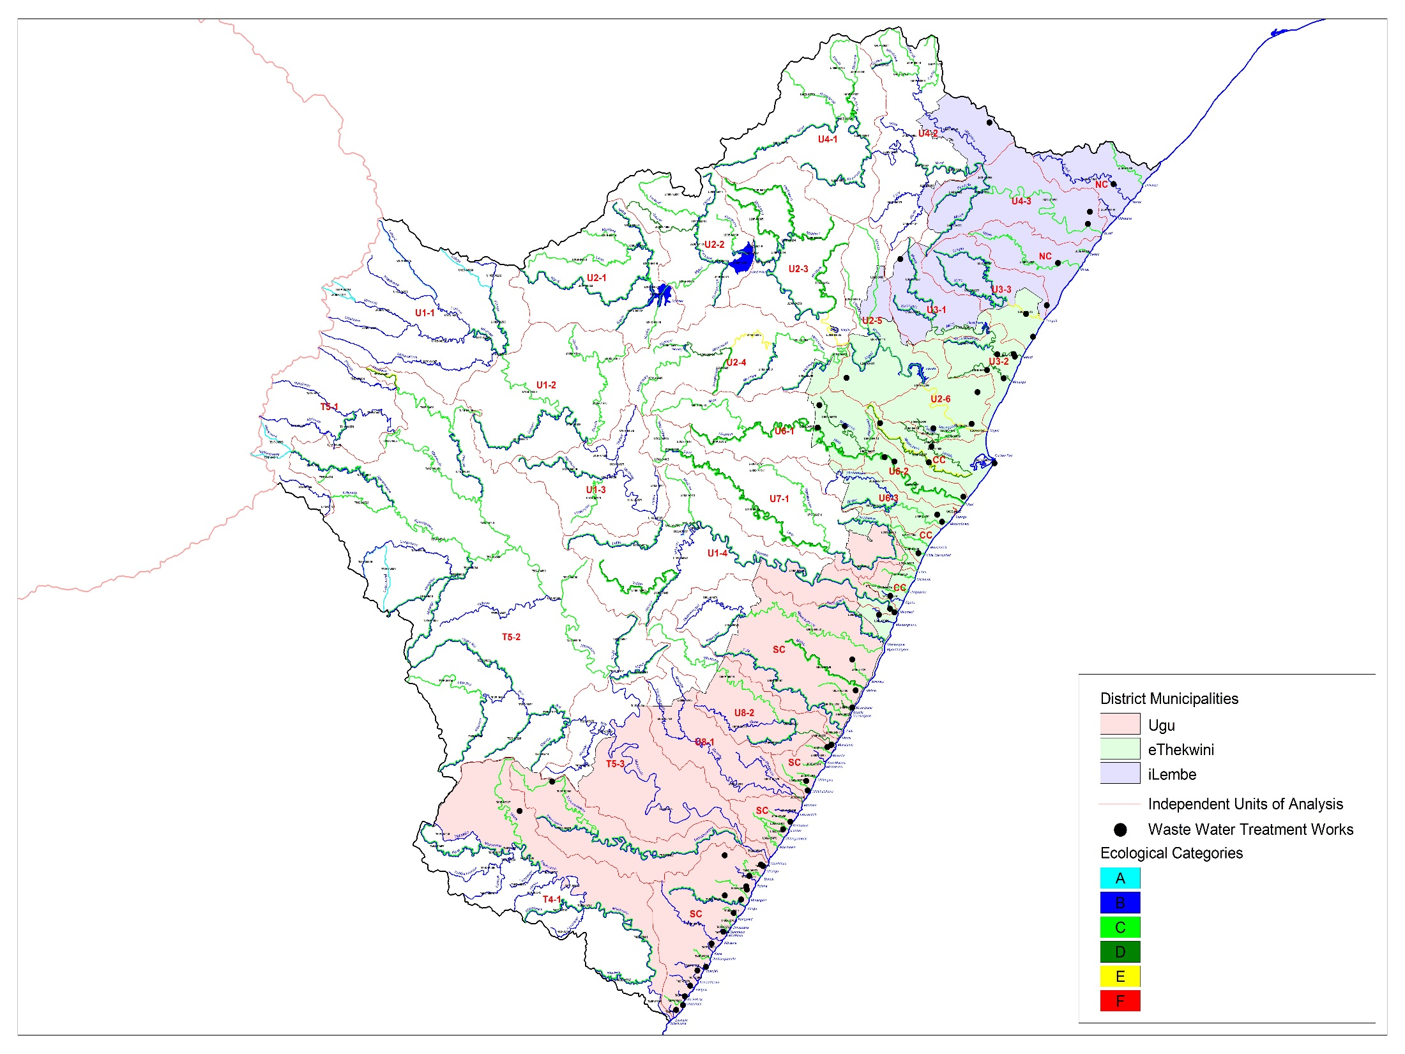
Central Cluster (CC)
16 Estuaries
eThekwini MM
Northern Cluster(NC)
7 Estuaries
iLlembe DM
Southern Cluster (SC)
41 Estuaries
Ugu DM
Notes:
Desktop vir riviere.

Slide 6
Discussion Scenario Definitions
Sc | Scenario Description | Comment
Ai | Ecological protection is priority (minimum discharge to estuaries) | N & S Clusters: 30% of future ww flow to estuary, remainder through marine outfall.
Aii | Ecological protection is priority (minimum discharge to estuaries) | N & S Cluster: Discharge current capacity, remainder disposal through marine outfall.
Bi | Minimum costs scenario (highest flow into estuaries) | Options for Central Cluster: Low nutrient discharge from (high costs)
Biii | Minimum costs scenario (highest flow through estuaries) | As Bi: Current treatment (high) nutrient discharge (low costs).
C | Current and short term (5 year) flow discharged into river systems, remainder through marine outfall. | N and S Clusters: Short term increases in discharges. Central Cluster: Short term increases in discharges with low nutrient discharge (high costs)
Ci | Current and short term (5 year) flow discharged into river systems, remainder through marine outfall. | Northern and Southern Clusters: Short term increases in discharges. Central Cluster: As C: Current treatment (high) nutrient discharge (low costs)
D | Current and medium term (10 year) flow discharged into river systems, remainder through marine outfall. | N and S Clusters: Medium term increases in discharges. Central Cluster: Low nutrient discharge (high costs)
C | Current and short term (5 year) flow discharged into river systems, remainder through marine outfall. | Northern and Southern Clusters: Short term increases in discharges. Central Cluster: Short term increases in discharges with low nutrient discharge (high costs)
E | Indirect re-use (consider volume and practicalities) Remainder According to Scenario C. | Northern and Southern Clusters: Reuse 50% if future ww flow. Central Cluster: Reuse via Hazelmere Dam.
F | Direct re-use (consider volume and practicalities) Remainder According to Scenario C. | N and S Clusters: Reuse 50% if future ww flow. Central Cluster: High level of treatment (high costs), supply into distribution system.

Slide 7
Central Cluster: Variables’ Scores

Slide 8
Variable Weights
Variables | Weights
Ecological Status | 0.5
Ecosystem Services | 0.1
Economic Indicator | 0.3
Employment | 0.1
50% Ecology
50% Socio-Economic

Slide 9
Central Cluster: Integrated Score
Cluster of scenarios with
equivalent rank

Slide 10
Observations
Scenario Ai implies removal of most waste water, although it is the best scenario, it is an extreme scenario. Will be disruptive to implement over the short term.
Both Scenario F (indirect reuse) and Scenario E (indirect reuse) achieve similar ecological health results. Sc F however has much higher cost implications than Scenario F.
Compare scenarios without F and Ai.

Slide 11
Central Cluster: Variables’ Scores
(excluding Ai and F)

Slide 12
Central Cluster: Integrated Score
(excluding Ai and F)

Slide 13
Observations
Scenarios E, indirect reuse (via Hazelmere Dam) can be considered as a long term option.
Scenarios D and C allow for development over the medium term.
Scenario B is ranked the lowest due to low level of protection (ecology).
Compare scenarios for Northern Estuaries together (uMdloti and uThongathi)
Adopt Scenarios D, Di, C and Ci for selection – further discussion, agenda Item 6.7.

Slide 14
uMdloti and uThongathi: Variables’ Scores

Slide 15
uMdloti and uThongathi:
Integrated Score
Central Cluster
Integrated Score

Slide 16
Observations
Scenarios E, indirect reuse (via Hazelmere Dam) can be considered as a long term option.
  All wastewater from uThonghati is reused (via Hazelmere Dam).
  All wastewater from uMdloti disposed through marine outfall for the scenario.
  Can improve scenario’s ecological score by adding wastewater flow to uMdloti estuary.
Therefore formulated a new scenario “Gi” (uMdloti).

Slide 17
uMdloti and uThongathi: Variables’ Scores

Slide 18
uMdloti and uThongathi:
Integrated Score
(with Scenario Gi)
Scenario Gi give best ranking, improvement to Scenario E.

Slide 19
Observations (uMdloti & uThonghati)
Scenario Gi:
  All wastewater from uThonghati is reused (via Hazelmere Dam).
  Increase wastewater discharged into uMdloti estuary.
Indirect re-use option could take many years to implement.
Interim option to accommodate development pressure: Allow further discharge into uThonghati (Ecological health will reduce to an EC = E over medium term.)
Design WWTW for expansion for indirect reuse. (Target Ecological Category over long term EC=C\D)
Further discussion, agenda Item 6.7.

Slide 20
Summary for Central Cluster
Scenarios D, Di, C and Ci to provide basis for further discussion for the Central Cluster in general, Scenario Gi to serve as guide for uMdloti & uThonghati.
Further discussion part of agenda Item 6.7.

Slide 21
Northern Cluster: Variables’ Scores

Slide 22
Northern Cluster: Integrated Score
Scenario | Flow into Estuaries (Ml/Day)
D | 20.9
Ai | 6.1
C | 17.2
Aii | 17.8
E | 19.8
Bi | 39.6

Slide 23
Southern Cluster: Integrated Score
Scenario | Flow into Estuaries (Ml/Day)
C | 22.8
D | 24.9
Ai | 11.1
Aii | 29.5
E | 18.5
Bi | 37.0

Slide 24
Observations and Conclutions
(Clusters SC & NC)
Scenario Ai require expensive alternative wastewater disposal measures in the short term (discard).
Scenario D and C, in general allow limited additional wastewater for increased developments. Further wastewater (over the long term) will have to be managed through alternative measures (prevent long term further discharges to estuaries.)
Future wastewater management studies should include an assessment of the estuary ecology (will benefit from additional monitoring information )
Discussion of individual estuaries part of agenda Item 6.7.

Slide 25
Perspective (uMngeni River System)
Current and planned system operating rules achieves ecological health objectives for the river EWR sites (flow related aspects).
Operation of the system in the period shortly before further augmentation could result in a the system and ecological conditions being “stressed” for a few years.
Full scale Multi-criteria Analysis was not required.

Slide 26
Perspective (Lovu River System)
Scenarios to reduce abstraction was formulated to determine if estuary health can achieve the Recommended Ecological Category.
Even with 50% reduction in abstraction (Scenario LO4) the REC for the estuary is not achieved.
Scenario LO4 will have large negative economic implications.
Full scale Multi-criteria Analysis was not required.
Further discussion as part of Item 6.7

Slide 27
  QUESTIONS FOR CLARIFICATION

